Slide 1

AHMAHF CORPORATION

Slide 2
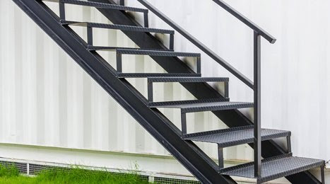
INTRODUCTION
WHO WE ARE?
About ahmahf fabrication & customisation is a private company.
It is classified as indian no- government company,mumbai
Our focus is to getting job done on time, within budget, to the highest standards.
AHMAHF MESSAGE
we pleased to welcome you to ahmahf fabrication & customisation.
Thank you for taking out time to look at us and I am sure you would find it exciting informative.
We bring to our client much wanted human values ,integrity , trust and an assurance of responsibility all coupled with our expertise in customisation , fabrication, engineering & management.
At AHMAHF fabrication we are passionate about achieving quality, outcomes and delivery ahmahf solution to our clients needs and challenges.

Slide 3
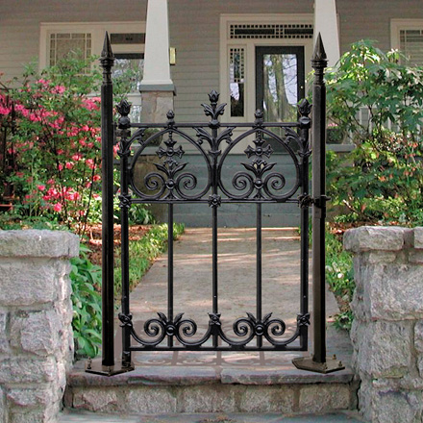
THINGS WHICH WE PROVIDE TO OUR CLIENT’S
GATES:
SLIDING GATES
ROLLING GATES
COLLAPSIBLE GATES
RAILINGS:
BALCONY RAILINGS
STAIRCASE RAILING
GRILLS:
DOOR GRILL
WINDOW GRILL
SHUTTERS:
MANUAL SHUTTER
GEAR SHUTTER
MOTORISED SHUTTER
DOORS:
SAFETY DOORS
STEEL WINDOW DOORS
FRAMES TERRACE DOOR
AWNING & FENCE:

Slide 4
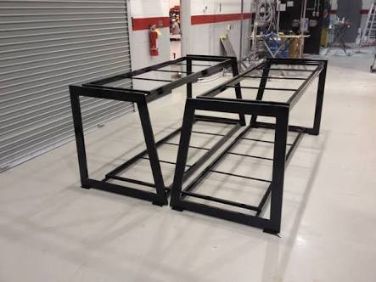
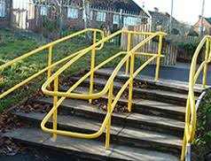
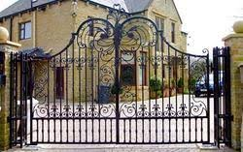
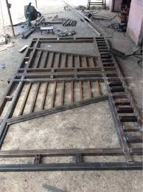
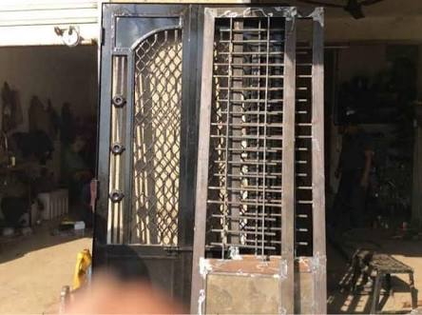
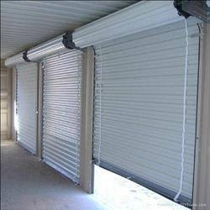
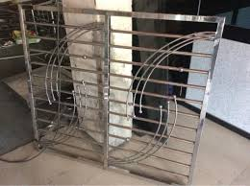
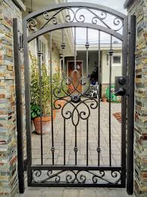
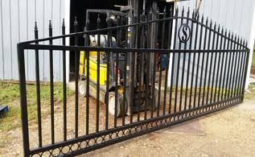
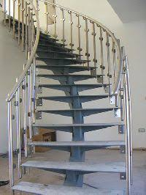
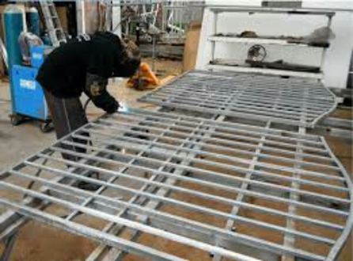
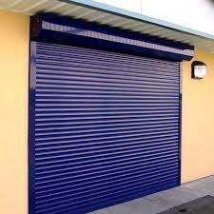
OUR PRODUCTS

Slide 5
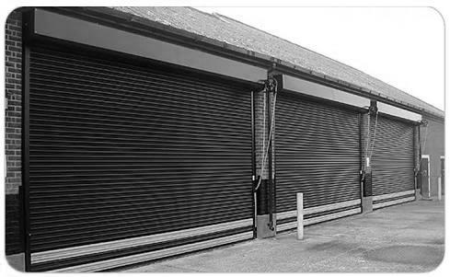
CO PARTNERS :
MUSTAFA LOKHANDWALA
ABDEALI JABALPURWALA
ROHIT UPADHYAY
SHADAB SHAIKH
CONTACT US :
+91-9870456025
+91-7400228552
+91-8369060723
+91-8369553447
WEBSITE & ID :
www.ahmahf.co.in
Ahmahf.corp@gmail.com
ADDRESS :
Sai suman apartment ,shop no.1,
Below sai mumbra hospital,
Thane -400612
OFFICE HOURS :
Sunday closed
Monday to Saturday
10:00 AM - 9:00 PM

